Slide 1














BLOCKCHAIN BASED E-VOTING SYSTEM
SECOND SEMINAR

Slide 2
SUPERVISORS
Dr. Dina Elsayad
TA. Manar Sultan

Slide 3
TEAM MEMBERS
Suhail Mahmoud
Heba Shaaban
Abdelrahman Hamdi
Rana Ahmed
Abdelrahman Osama
Habiba A. Abdulkader

Slide 4


AGENDA
01
02
03
04
Problem Definition
System
Architecture
Motivation
Objective
05
06
07
08
Data
Creation
Face Verification
ID Data
Extraction
Fake ID
Detection
09
10
11
12
Blockchain
Frontend
Time Plan
Next Phase

Slide 5

01
PROBLEM DEFINITION

Slide 6
PROBLEM DEFINITION
Current voting systems face various security and transparency issues, including fraud, manipulation, and lack of trust from the public. Traditional systems make it challenging to securely identify voters while keeping their identities private. These vulnerabilities highlight the need for a reliable, decentralized solution to ensure vote integrity, transparency, and user privacy.

Slide 7
02
MOTIVATION

Slide 8
MOTIVATION
The main motivation is to build a secure and transparent e-voting platform that leverages blockchain's decentralized structure to provide an immutable record of votes. Additionally, it utilizes AI technology for user authentication, ensuring that only verified users can participate and that each vote remains anonymous and unaltered.

Slide 9
03
OBJECTIVES

Slide 10
OBJECTIVE
The main goal of this project is to develop an online voting system with blockchain as its core foundation and AI-powered identity verification. This system will :
Ensure privacy and trust in voting processes, benefiting governments, organizations, and private entities seeking secure voting solutions.
Enable real-time, auditable, and transparent voting records.

Slide 11
04
SYSTEM
ARCHITECTURE

Slide 12





Facial Recognition
Verified User
Frontend
Enterface
User
Feature
Extractions
AI
Verification
Blockchain
Encryption / Decryption Module

Slide 13

Facial Recognition
User
Verified User
Frontend
Enterface
Feature
Extraction
AI
Verification
ID
Data Extraction
AI
Verification
Blockchain
Encryption / Decryption Module
Feature
Extraction

Slide 14
05
DATA
CREATION

Slide 15
DATA CREATION
WHAT IS THAT?
we was need to collect and create Egyptian national ID Dataset.
WHY?
Security: Verifying the user’s national id, we can prevent impersonation and unauthorized access.
Integration: AI verification integrates seamlessly with the blockchain to reducing administrative overhead.

Slide 16
DATA CREATION
HOW?
First, by Collecting all data found , Then the stage of filtering start by remove all redundant data and only keep the Unique data
sites that found data on it (roboflow, facebook, google, github).
after collecting, we got over 32K image.
after filtering, we got only 8,649 Unique Real Images (probably).

Slide 17
DATA CREATION
Filtering
First, some data filtered manually.
Second, using some regex technique for names of images.
Third, using some some CNN Network like..
Simple CNN Network.
MobileNetV2.
“of course with manual review”.
Page 17

Slide 18
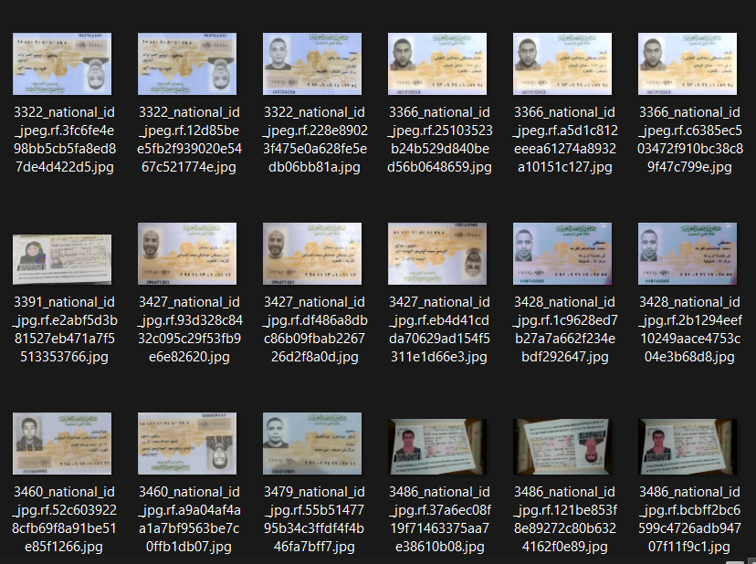
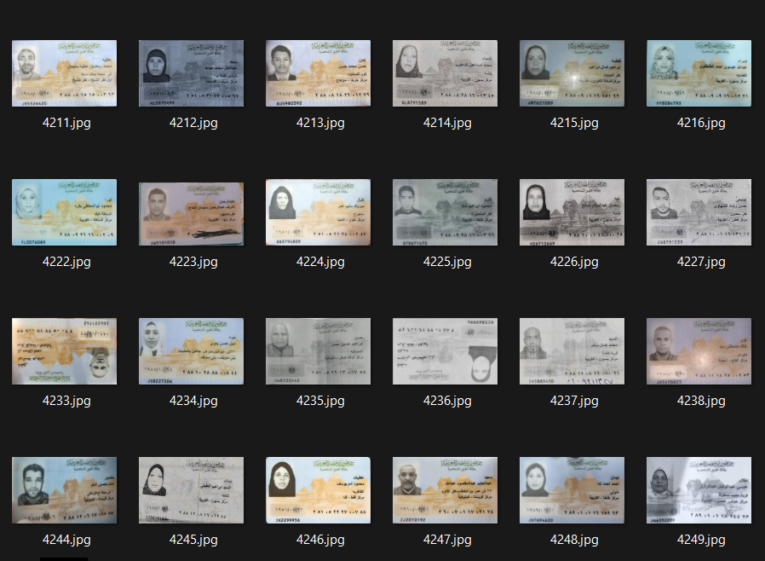
DATA CREATION
Before
After

Slide 19
DATA CREATION
we collect the Unique identity from data
VggFace2 (8631 identity).
CelebA (10177 identity).
Synthetic Faces High Quality (SFHQ) part 4 (125K identity).

Slide 20
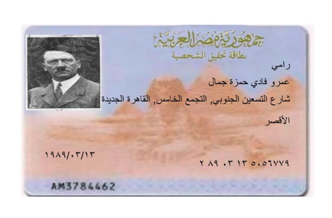
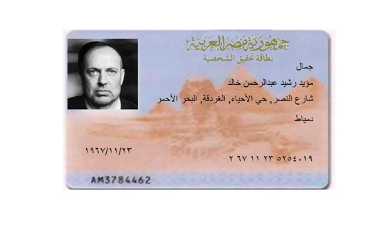
DATA CREATION

Slide 21
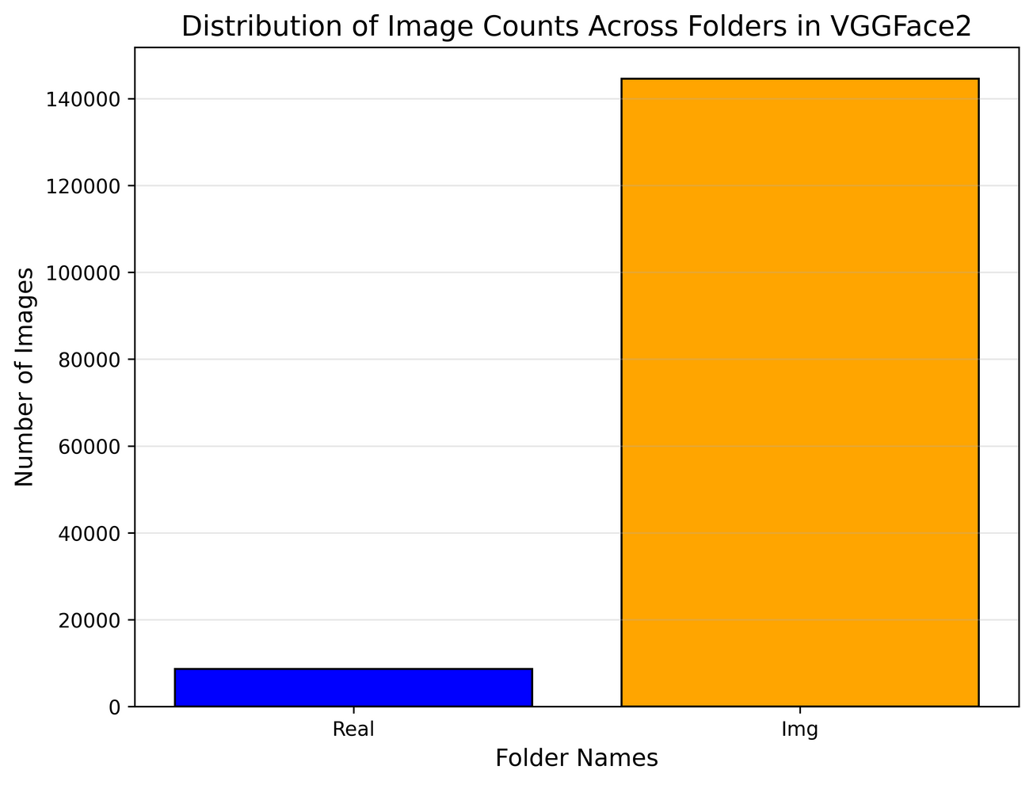
DATA CREATION
SO with 8649 real and over 144K Img.
we had over 153K Egyptian ID Card.
it is now on Kaggle.

Slide 22
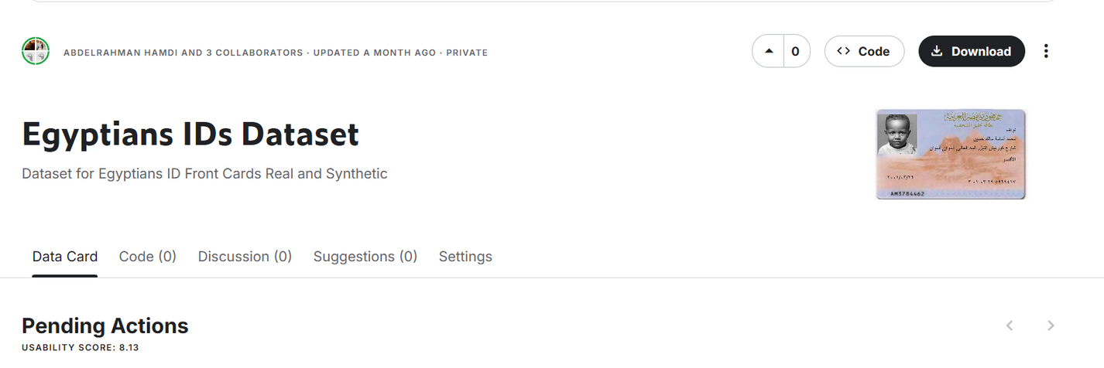
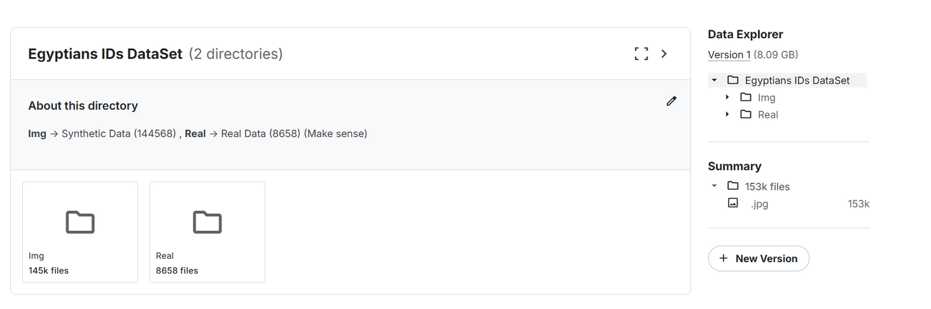
DATA CREATION
Here We Go

Slide 23

06
FACE
VERIFICATION

Slide 24
FACE VERIFICATION
WHAT IS THAT?
AI-based facial recognition module will ensure voter authentication.

Slide 25

Dataset: VGGFace2
Overview
Includes over 3.3 million images.
Contains over 9,000 identities.
Diversity in terms of pose, ethnicity, and lightning conditions.
Features
Pose Variation: Includes faces captured at various angles.
Expression Diversity: Includes images with a wide range of facial expressions.
Backgrounds: Includes images with varied backgrounds to improve generalization.

Slide 26
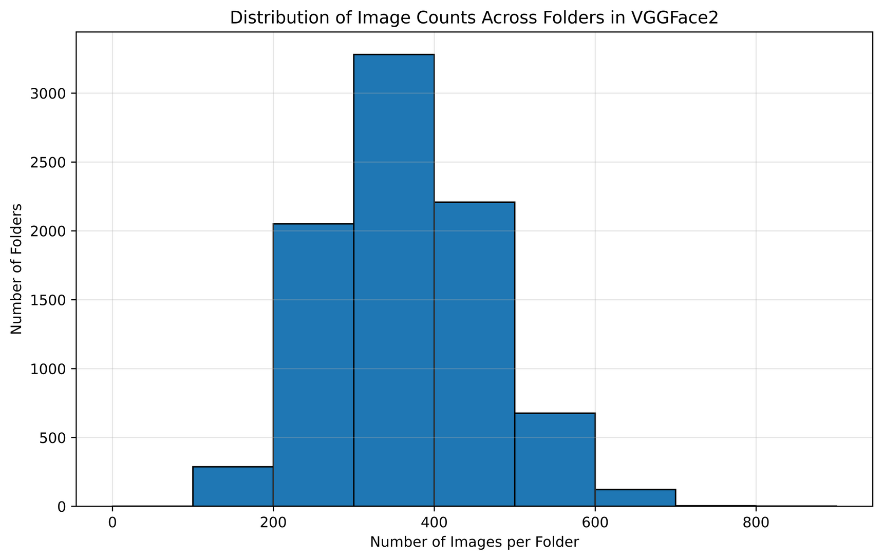
Analysis
Total Number of Identities : 8631
Total Number of Images : 3141890 (3.14M)
Min images per folder : 87
Max images per folder : 843
Average images per folder : 364.02

Slide 27
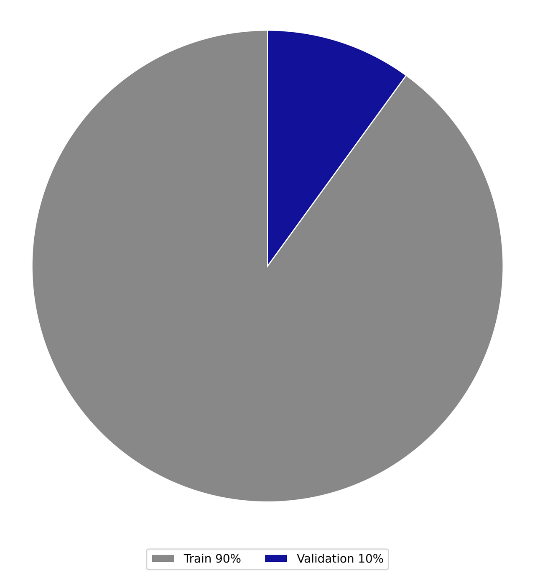
Preprocessing
Split
Train : 7767 (90%)
Validation : 864 (10%)
Train
Detect Face (MTCNN)
Resize (160 x 160)
Augmentation
Horizontal Flip
Rotation
Color
Tensor
Generate Triplets

Slide 28
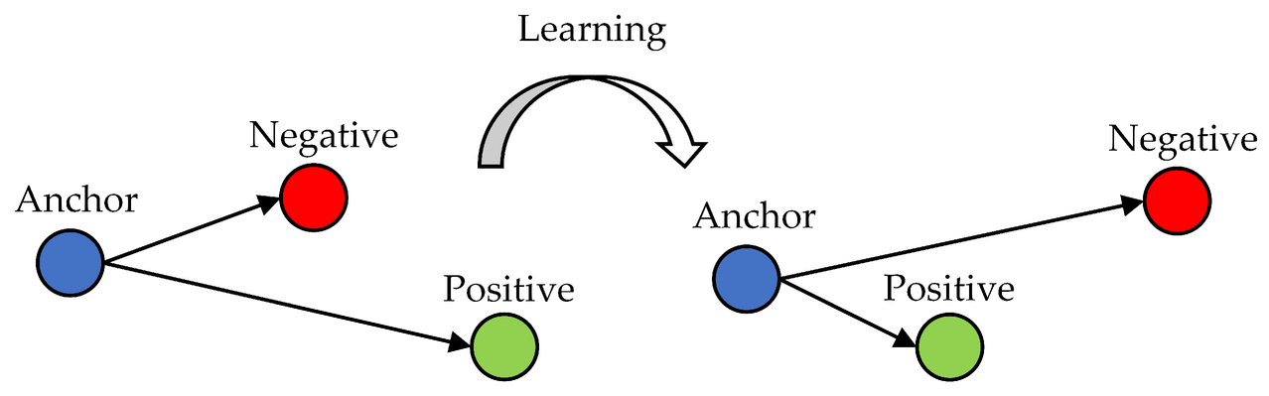
Preprocessing
Test
Detect Face (MTCNN)
Resize (160 x 160)
Generate Pairs
Triplets
Anchor , Positive from the SAME Class
Negative from different Class

Slide 29
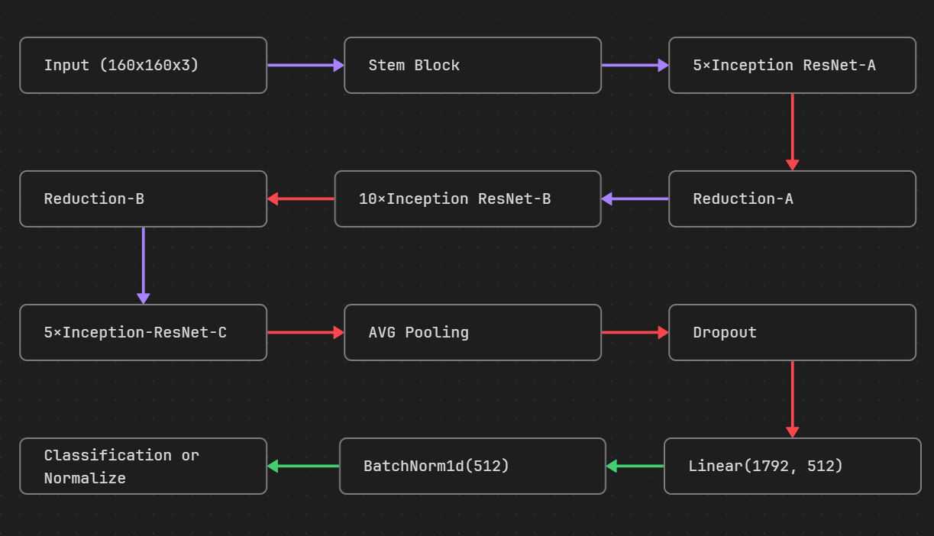
Model: InceptionResnet-V1

Slide 30
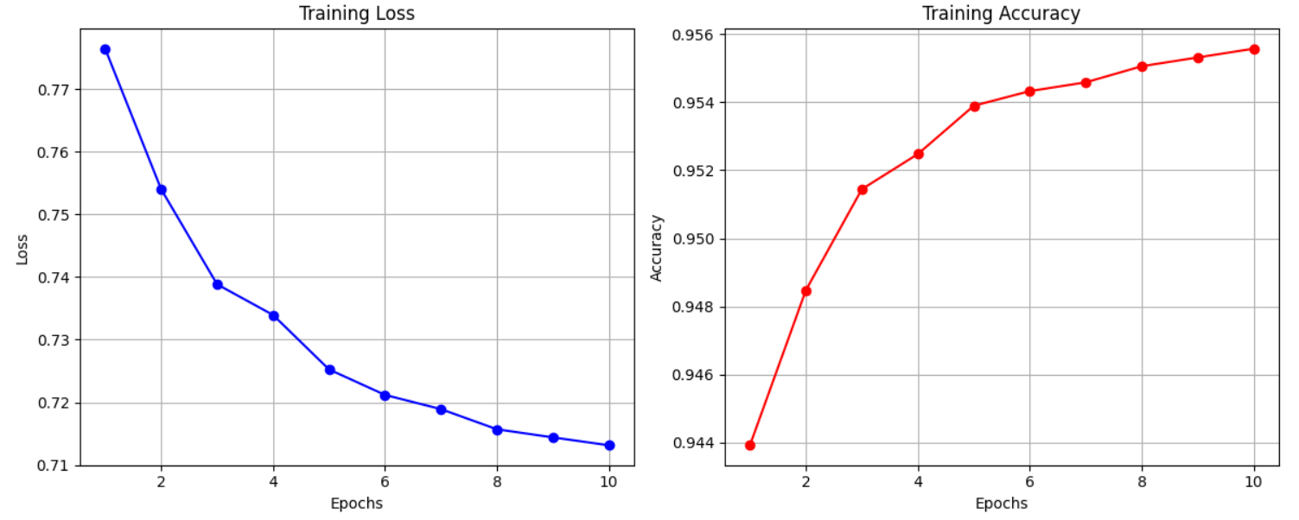
Result

Slide 31
Result
Model | VAL_Accuracy | Test_Accuracy | Precision | Recall | F1-Score
Resnet50 | 77 | 62.91 | 33.50 | 79.09 | 47.07
Inception Resnet-V1 | 90.28 | 95.13 | 85.67 | 92.03 | 88.74

Slide 32

08
ID DATA
EXTRACTION

Slide 33
ID VERIFICATION
Why Do We Need ID Verification?
🧾 Problem:
In digital voting systems, anyone can enter a national ID number manually.
But…
➡️ How do we know if this number really matches the person's ID?

Slide 34
ID VERIFICATION
🎯 Our Solution:
We detect and extract the national ID number directly from the uploaded ID image (using our YOLOv8 models and OCR), then:
🟡 Compare it with the manually entered ID number

Slide 35


Slide 36
DataSet:
Dataset Name: Egyptian-ID-Dataset
Sources: Roboflow
Usage Breakdown:
for YOLO Model 1 (ID Detection): 4200 images to detect ID cards within larger images
for YOLO Model 2 (Field Detection): 150 images to detect fields like Name, ID Number, Birthdate, etc.

Slide 37
Pre Processing
01
02
ID Detetction DataSet
(4200 image )
Fileds Detection DataSet
(150 image)

Slide 38
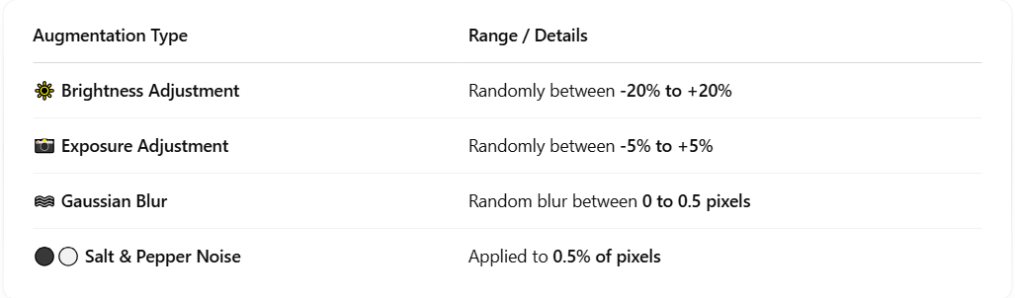
Pre Processing & Augmentation

Slide 39
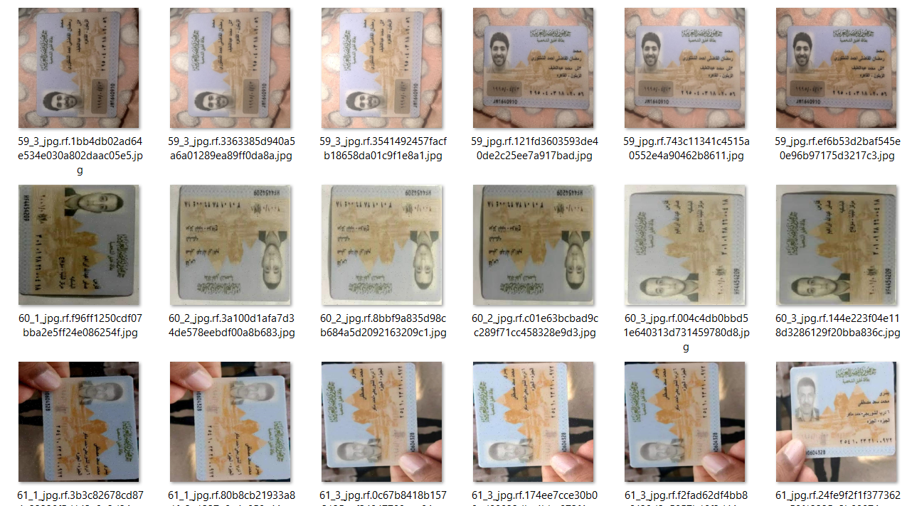
Augmentation Real Example

Slide 40
Pre Processing
01
02
ID Detetction DataSet
(4200 image )
Fileds Detection DataSet
(150 image)

Slide 41
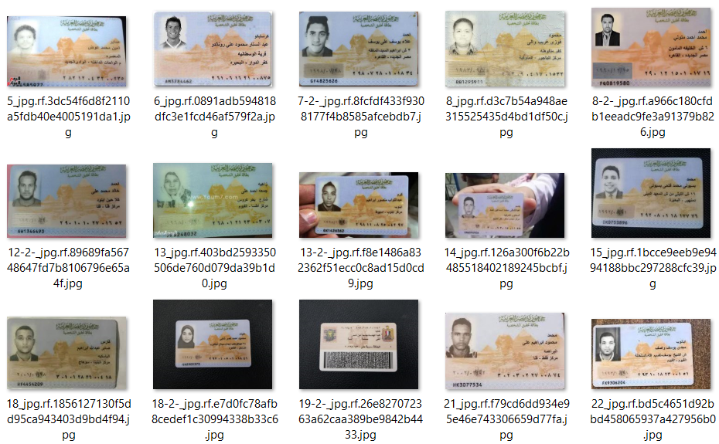
No Augmentation Needed

Slide 42
Datasets Pipeline Using Roboflow
Splitting
Labeling
dataSet.yaml
Page 42

Slide 43
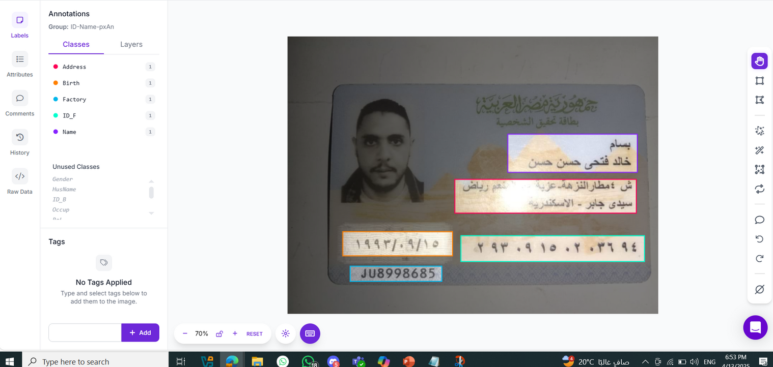
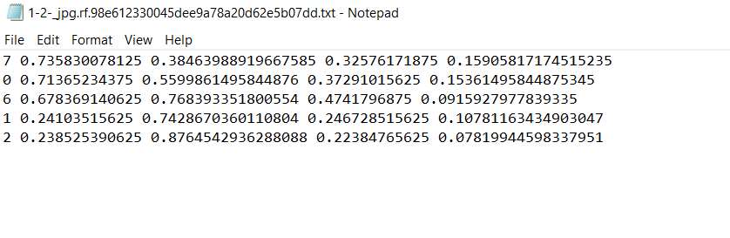
Labeling using Roboflow Tools
class_id x_center y_center width height
Page 43

Slide 44
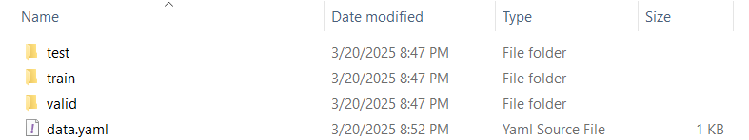
🗂️ splitting Dataset using YOLOv8 format
DataSet Splits into:
70% Training
20% Validation
10% Testing
Annotated via Roboflow
After collecting and labeling the dataset in Roboflow, we downloaded the YOLOv8-compatible format”
Data Set Strucure :
📂 train/
├── images/
└── labels/ ← Each .txt file contains bounding boxes for fields in the image
📂 valid/
📂 test/
📄 data.yaml ← Defines class names and paths

Slide 45

Let’s fine-tune our models

Slide 46
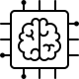
Model Selection
Why we Choose Yolov8 ?
We Used YOLOv8n.pt from Ultralytics
Because it’s Lightweight and fast — good for prototyping

Slide 47
Model 1: Detect ID Card inside image

Slide 48
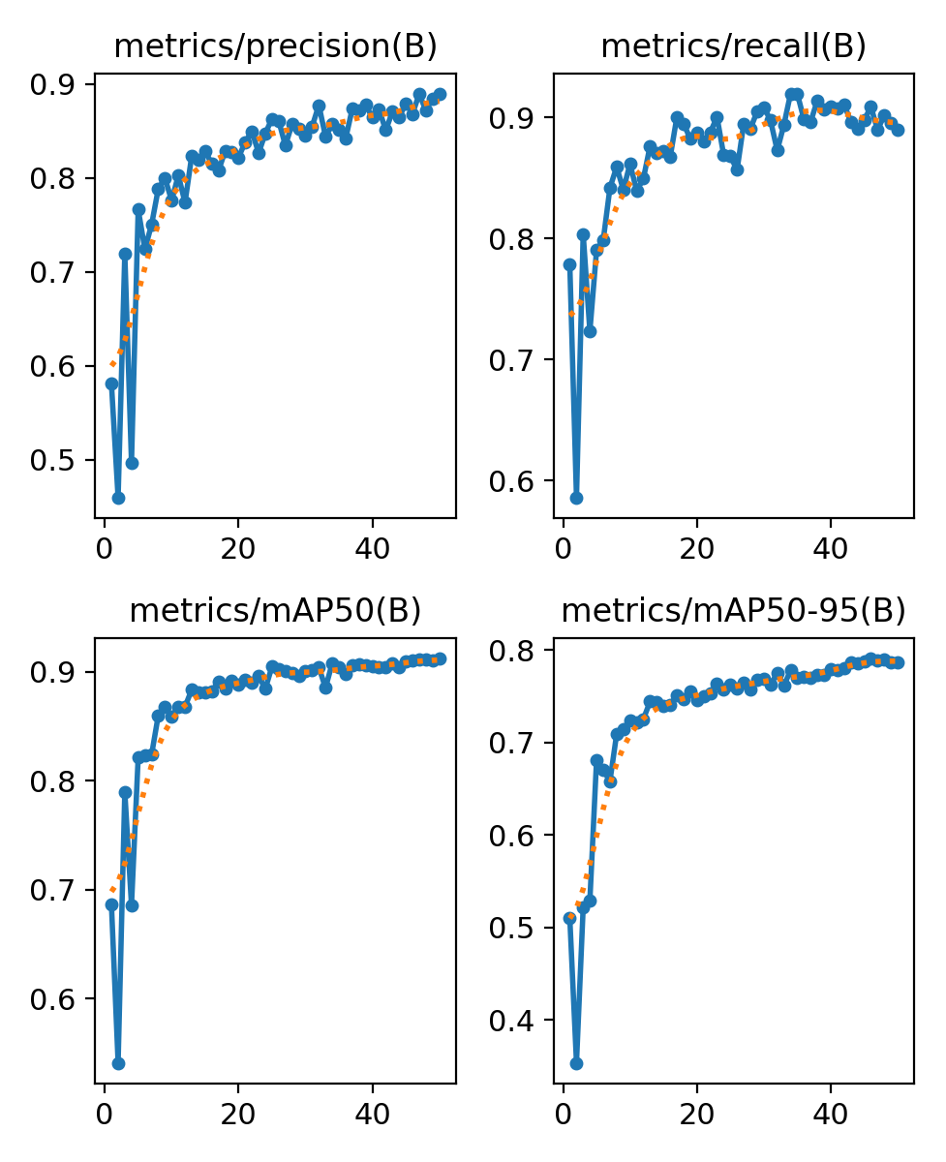
Model Performance
Started at 0.58 (epoch 1), reached 0.89 by epoch 50
Precision (B): 0.890
Recall (B): 0.890
mAP50 (B): 0.912 (IOU)
mAP50–95 (B): 0.787
Page 48

Slide 49
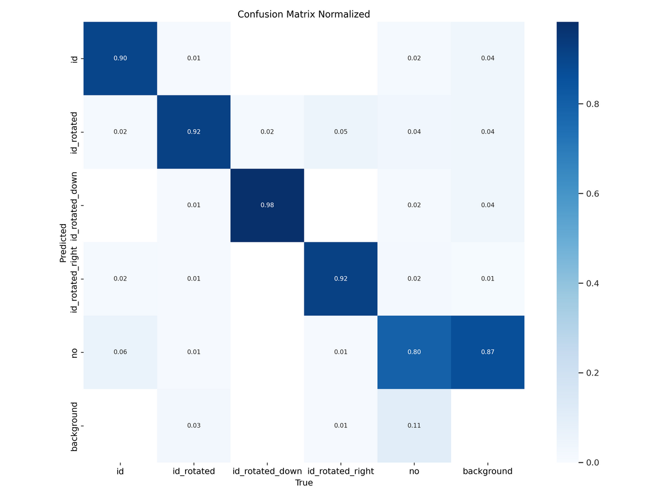
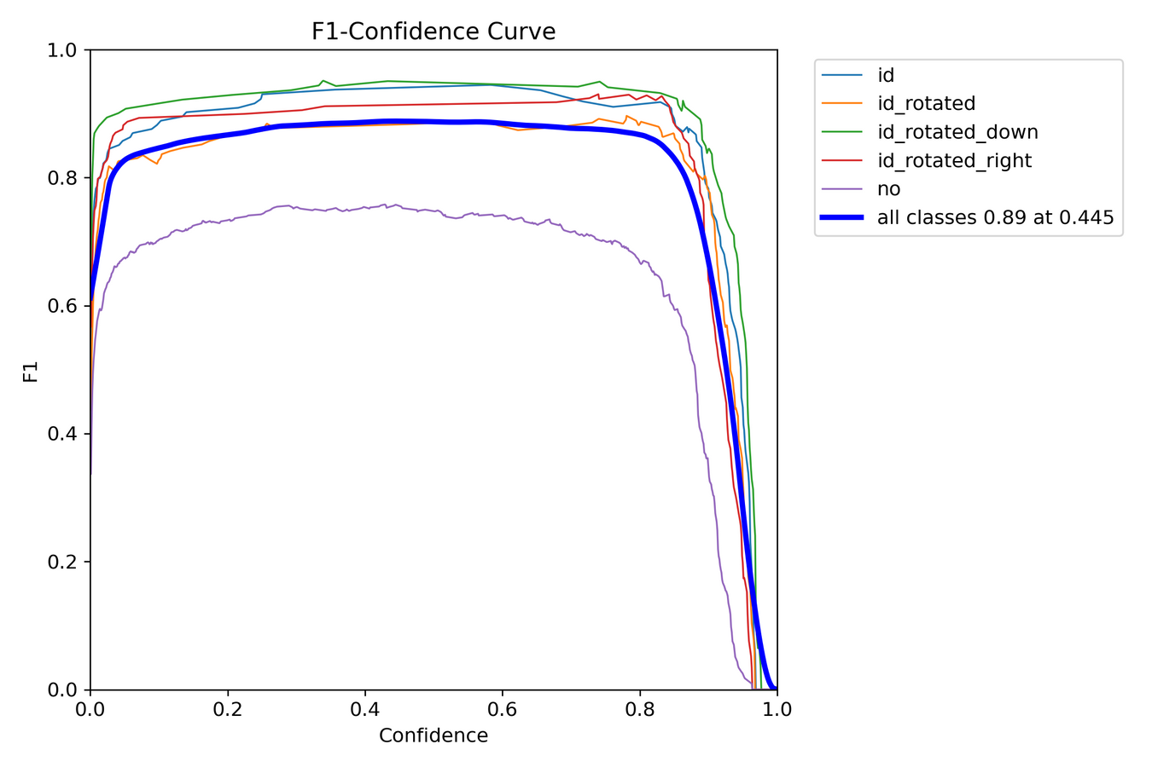
Confusion Matrix
F1-Curve

Slide 50
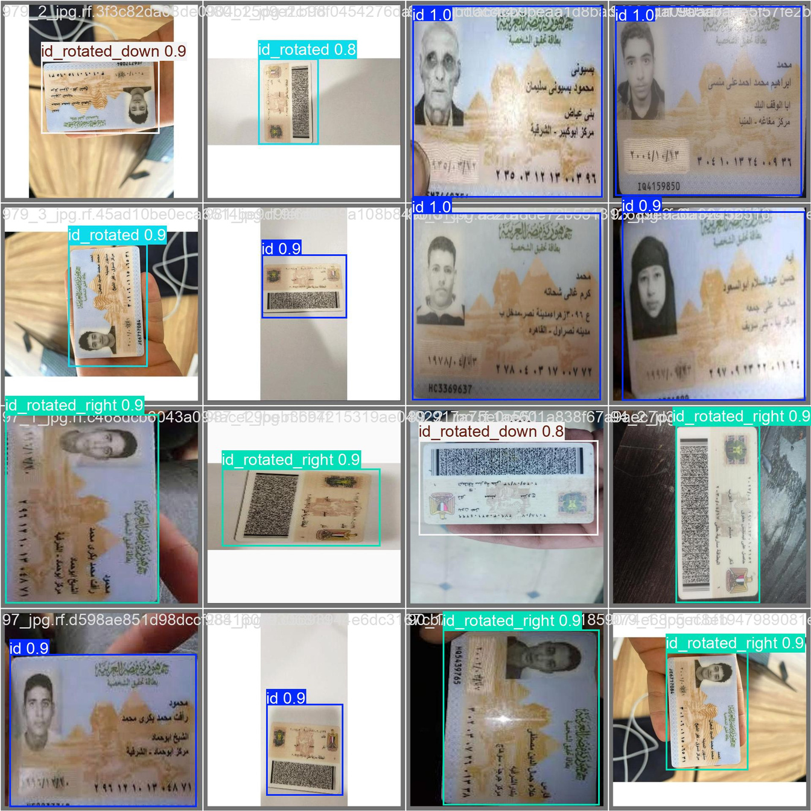
Predictions
id_rotated_down: 98%
id_rotated: 92%
id: 90%
id_rotated_right: 92%

Slide 51
Model 2: Detect Feilds inside ID Card

Slide 52
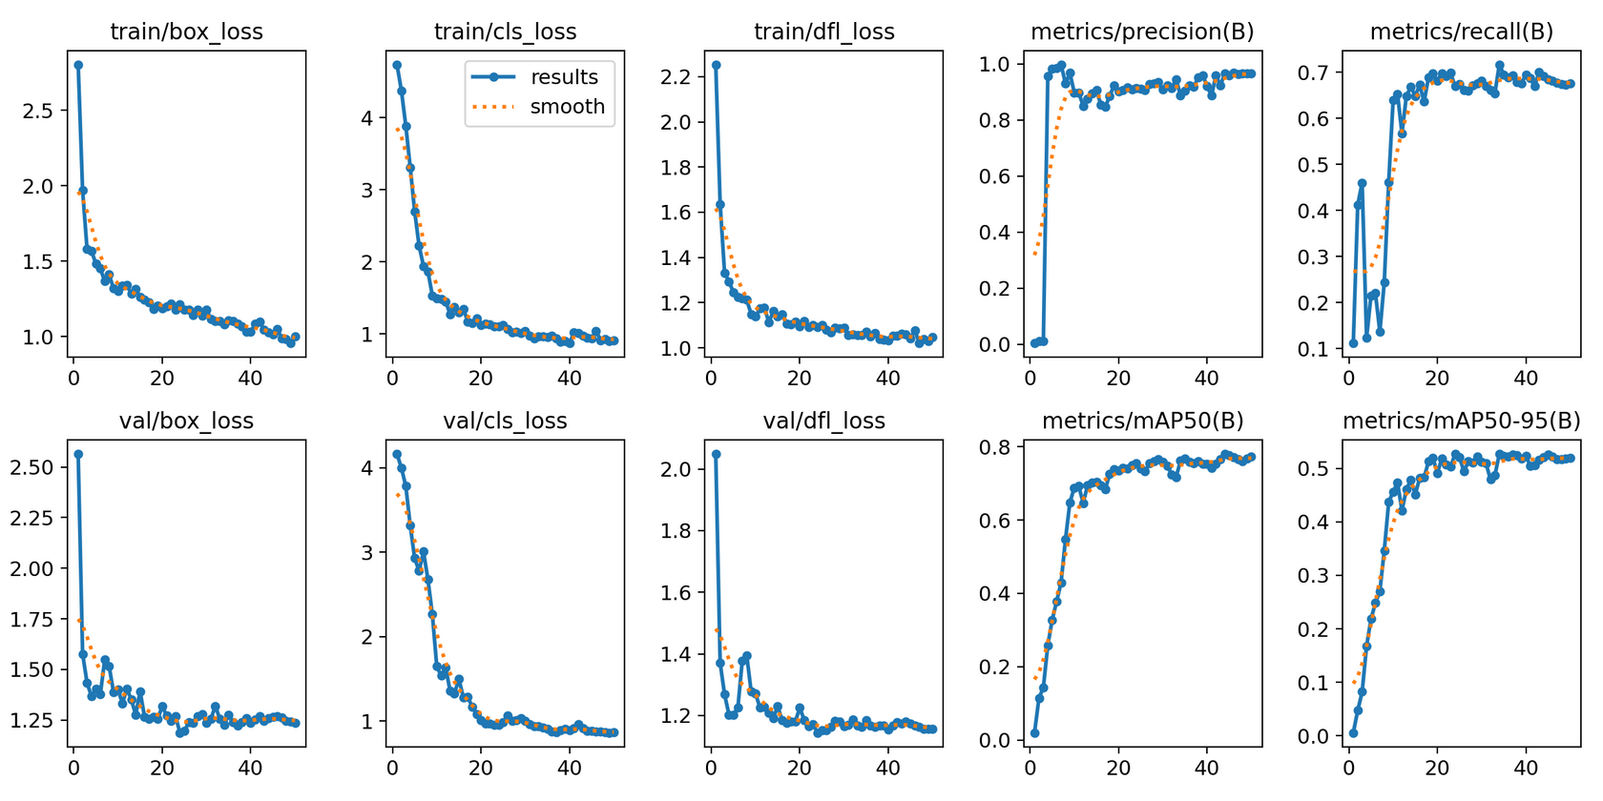
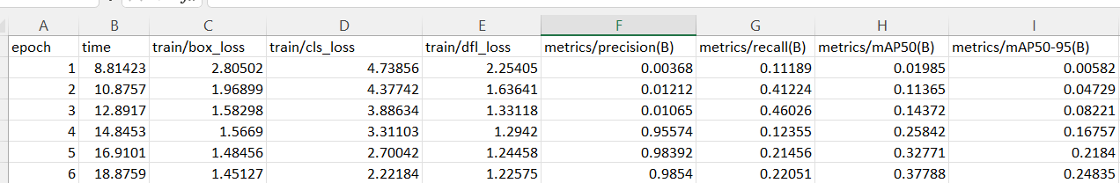
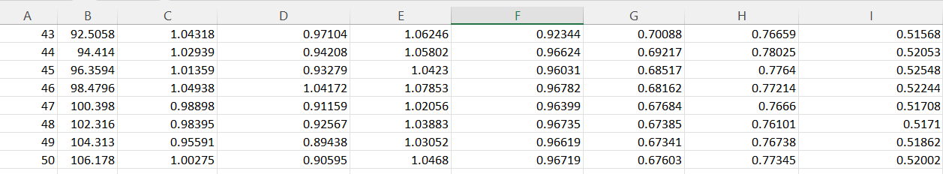
Performance
Precision (B): 0.96719
Recall (B): 0.7060
mAP50 (B): 0.77345

Slide 53
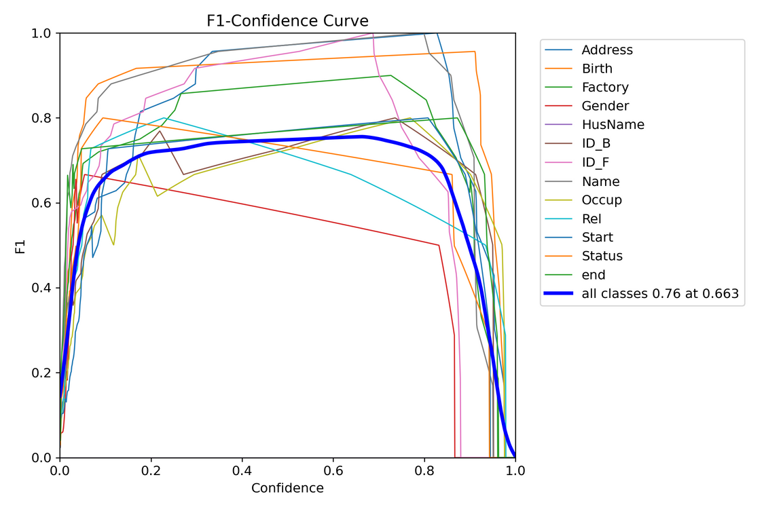
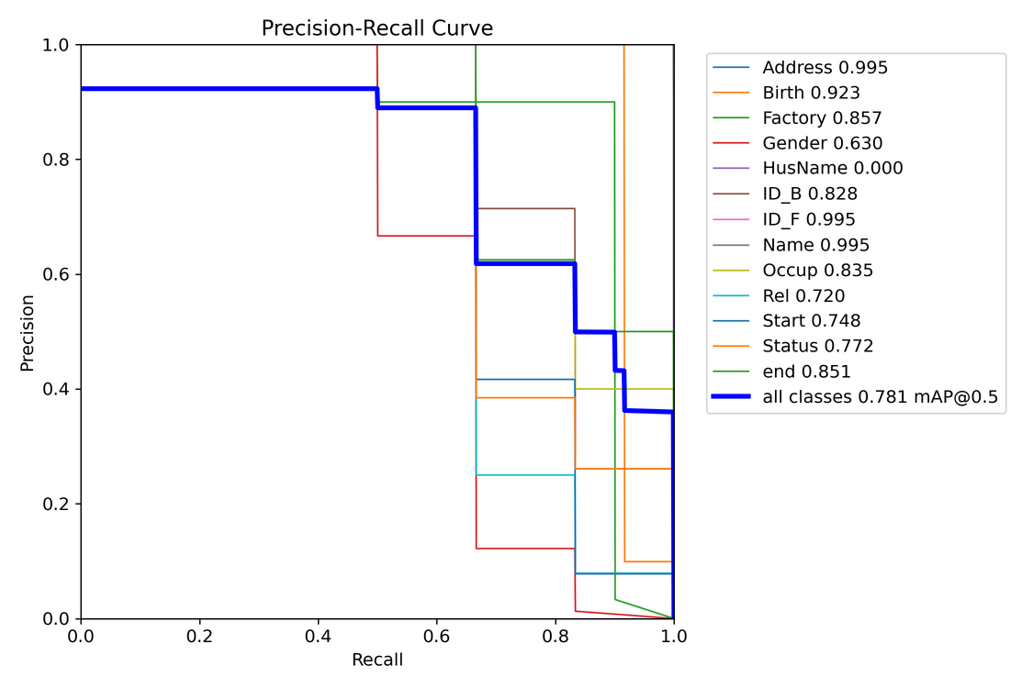
F1-Curve
PR Curve

Slide 54
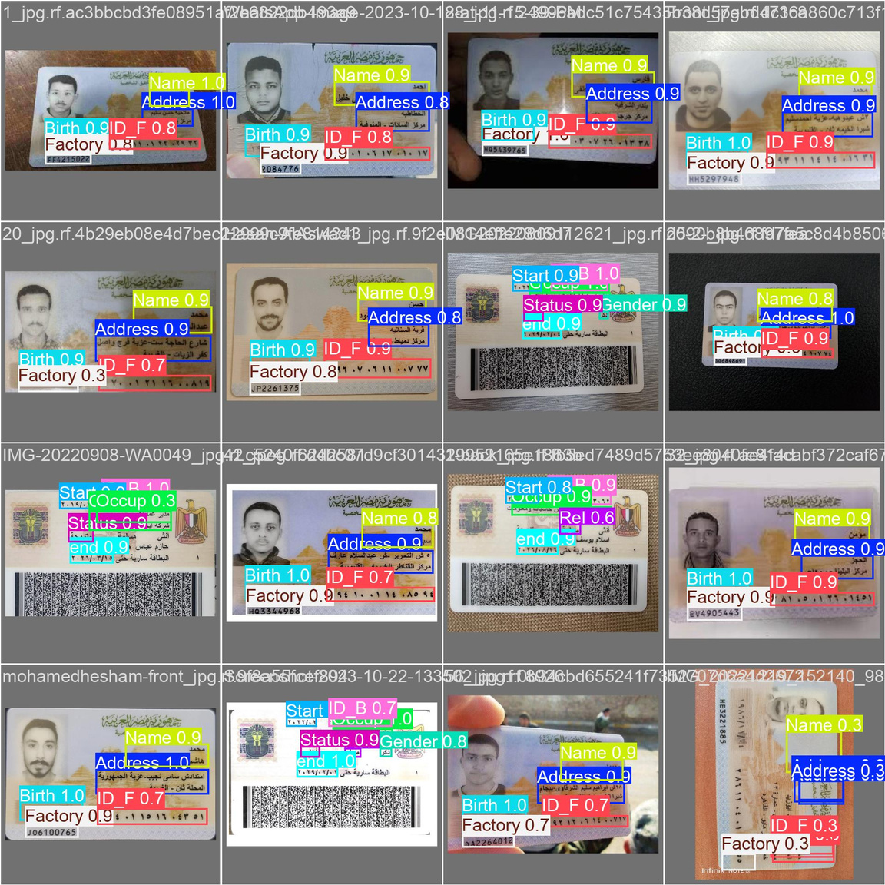
Test Results

Slide 55
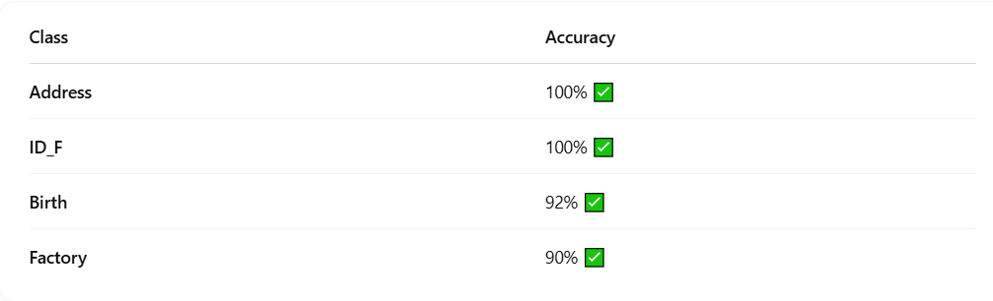
🎯 Top Performing Classes

Slide 56

ID Extraction Phases
01
02
03
ID detection using YOLO
Field detection using YOLO
Content extraction using OCR
Phase 1
Phase 2

Slide 57
Phase 1 Summary
🔹 YOLO Model 1: ID Detection
This model detects and localizes the National ID card within a larger image, especially useful if the ID is placed on a cluttered background or captured from a camera.
🔹 YOLO Model 2: Field Detection
After cropping the ID, we feed it to a second YOLO model trained to detect individual fields on the card: national ID number, name, date of birth ,gender ..etc.

Slide 58
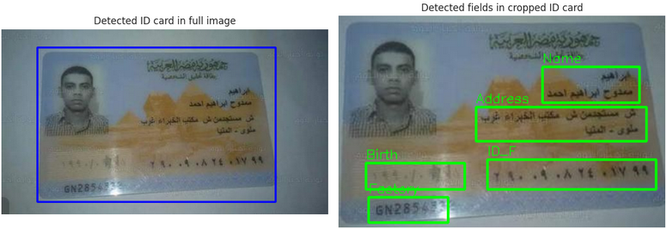
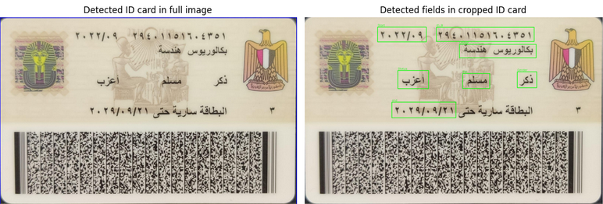
Phase 1 Final Results
This two-step detection helps us isolate only the relevant parts of the ID for further processing
National ID front sample
National ID back sample

Slide 59

READY FOR
PHASE 2

Slide 60
🧾 Why OCR is Needed
To automatically read the text content from the Egyptian National ID provided during voter registration,
so we can extract and verify key information such as:
🆔 National ID Number
🧑‍💼 Full Name
📅 Date of Birth
This ensures the user-provided data matches the official ID, enabling a secure and automated identity verification process.

Slide 61
OCR and Field Extraction
After detecting the National ID and its individual fields using our two-stage YOLO pipeline, we crop each detected field and pass it to our OCR module for text recognition.
We used EasyOCR, a deep learning–based text recognition model that supports both Arabic and English scripts. This was essential for accurately extracting the ID content, especially the Arabic numbers, and converting them into English digits to match the format that will be provided by the user during the voting process.

Slide 62
Why EasyOCR?
✅ Multilingual Support
Supports both Arabic and English, which is essential for Egyptian National IDs.
✅ Deep Learning-Based
Uses CRNN + CTC decoding, providing high accuracy for real-world images with mixed fonts and noisy backgrounds.
✅ No Training Required
Pretrained and ready to use — saved time and effort compared to building a custom OCR from scratch.

Slide 63
Why EasyOCR?
✅ Field-Level Flexibility
Performs well on small cropped fields, which matches our YOLO-based pipeline.
✅ Lightweight and Easy to Integrate
Simple Python API that fits easily into our preprocessing and post-processing pipeline.

Slide 64
OCR Workflow
01
02
03
ID detection using YOLO
Field detection using YOLO
Content extraction using OCR
01
02
03
04
Apply
EasyOCR
model
Preprocessing
Post-
Processing
Final Output

Slide 65
Preprocessing for OCR Accuracy
Before feeding the cropped fields into the OCR model, we applied several preprocessing steps to improve accuracy:
Grayscale conversion to simplify the image and focus on text.
Inverse thresholding to enhance contrast between text and background.
Resizing the image to make small text more readable for OCR.
Noise reduction by simplifying the image structure.
These steps significantly improve OCR performance and ensure the extracted data is clean and usable.

Slide 66
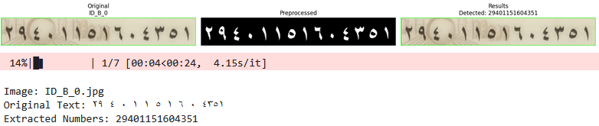
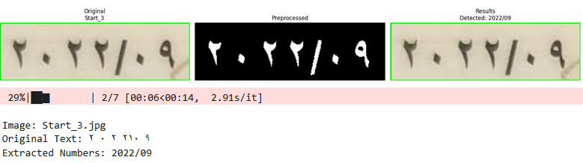
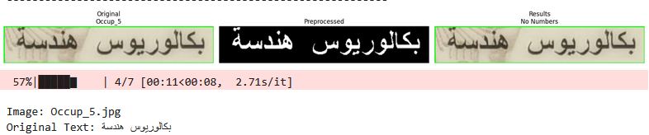
Preprocessing for OCR Accuracy

Slide 67
Post-Processing for OCR Accuracy
We applied custom post-processing techniques to improve text extraction quality:
Converted Arabic digits to English
Extracted clean numeric values (e.g., NID, dates)
Removed unwanted symbols and spaces
Fixed OCR errors like slashes misread as "1"
This approach helps us accurately extract numeric fields for use in our e-voting system.

Slide 68

FINAL
RESULTS

Slide 69
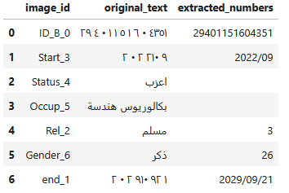
OCR Final Results
This table is generated automatically after running the full pipeline on a batch of ID images.
Each field is detected, cropped, preprocessed, and passed through OCR.
The result is then cleaned and normalized to ensure it’s accurate and consistent then saved as CSV file.

Slide 70
07
FAKE ID
DETECTION

Slide 71
ID CARD VERIFICATION MODEL
Purpose:
Detects fake IDs by analyzing image inconsistencies using AI + forensics techniques (ELA & LBP).
Why It Matters:
Used for identity theft & fraud detention .
Catches what humans miss under time pressure.
Learns subtle tampering patterns automatically.

Slide 72
PREPROCESSING
we use two forensic techniques:
Error Level Analysis (ELA): highlights areas of an image that may have been edited by showing differences in compression quality.
Re-compresses images at 90% quality.
Compares with the original to highlight edited regions.
Amplifies differences by 15× so Tampered areas appear brighter.
ELA acts like a Photoshop detector.

Slide 73
PREPROCESSING
2. Local Binary Patterns (LBP): detects texture patterns in an image to find inconsistencies that might indicate tampering.
Analyzes neighborhood pixel relationships.
Encodes texture patterns as numerical features.
Detects Variations in fonts/backgrounds.
LBP acts like fingerprint scanner for image textures.

Slide 74
PREPROCESSING
Feature | ELA | LBP
Detects | Digital tampering | Physical tampering
Best for | Photoshopped regions | Printed/Scan quality issues
strengths | Catches subtle digital edits | Works on physical copies
Outputs | Heatmap of edits | Texture pattern map

Slide 75
MODEL ARCHITECTURE
Three-Branch Hybrid Network:
Original Image Branch: EfficientNetB0,cause it recognizes fine details.
ELA Branch: Processing layer, it finds editing traces.
LBP Branch: Processing layer,it catches physical tampering.
Feature Fusion from all three branches.

Slide 76
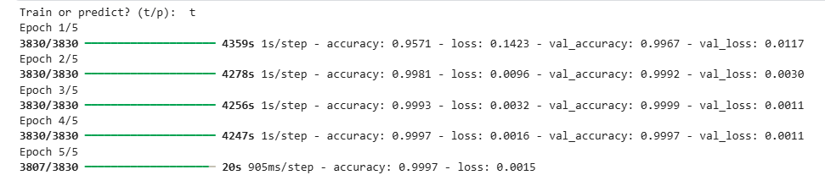
•The model gets accuracy of 99.9% on train and 99.9%on validation

Slide 77
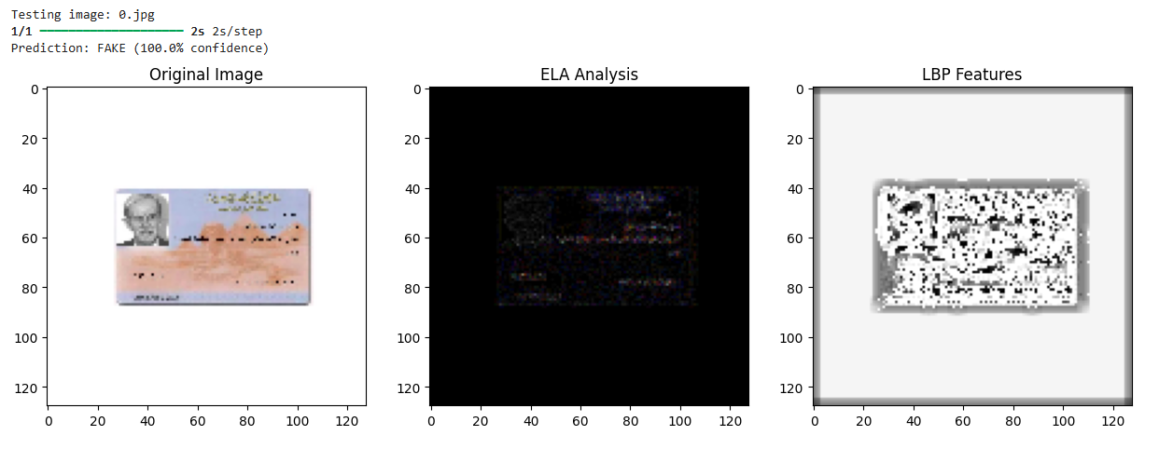
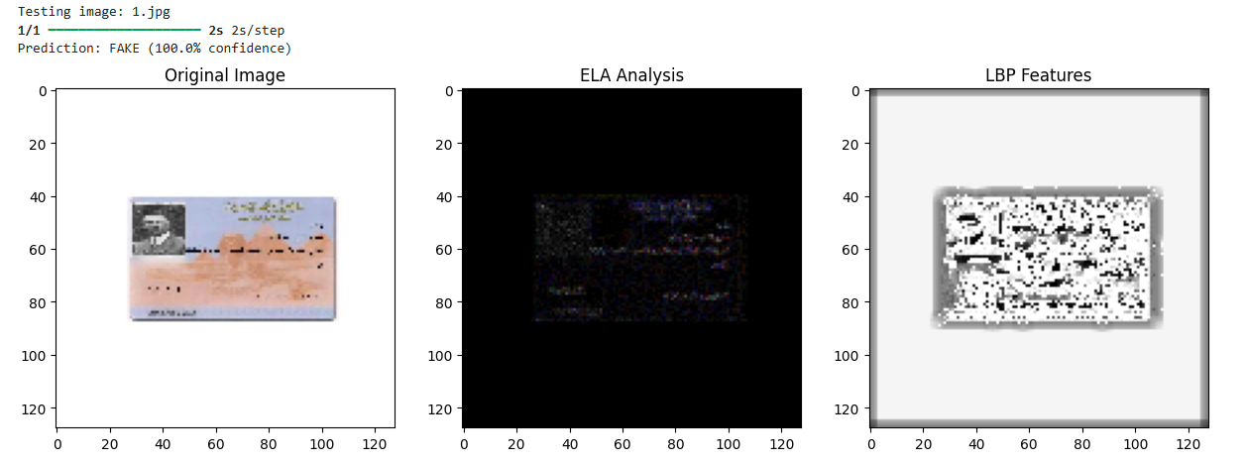
•And here are samples of the test on fake id cards

Slide 78
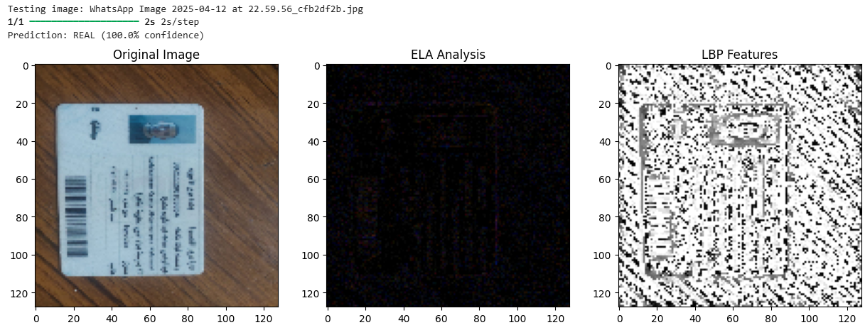
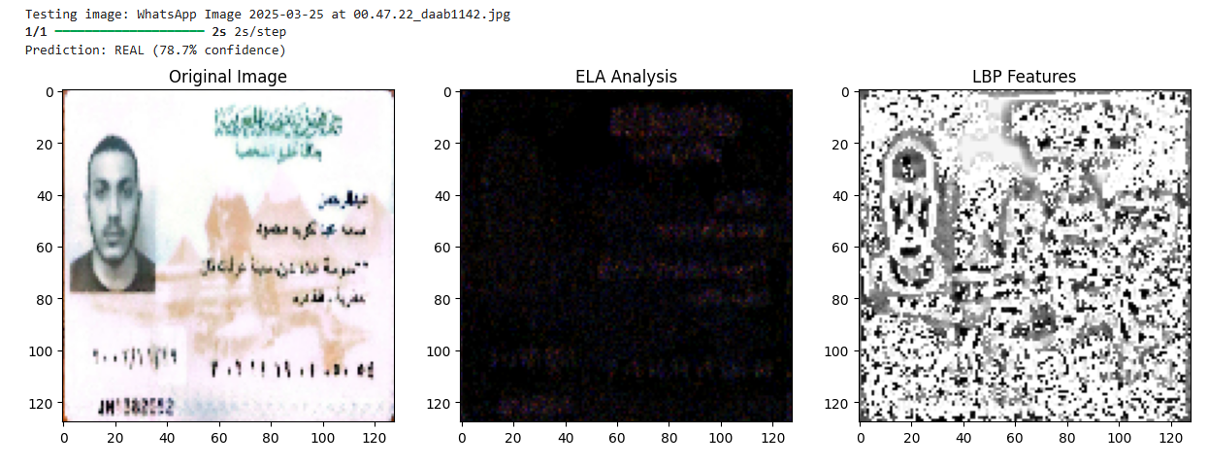
•And here are samples of real id cards

Slide 79
09
BLOCKCHAIN

Slide 80
Implementation
User Registration & Verification
Creating Proposals
Casting Votes
Retracting Votes
Changing Votes

Slide 81
Voter Registration
Voters are verified and registered
Create Proposal
A new voting proposal is created
Cast Vote
Voters cast their votes on a proposal
Tallying
Votes are automatically tallied during the proposal period
Change / Retract Vote
Voters can change or retract their vote

Slide 82
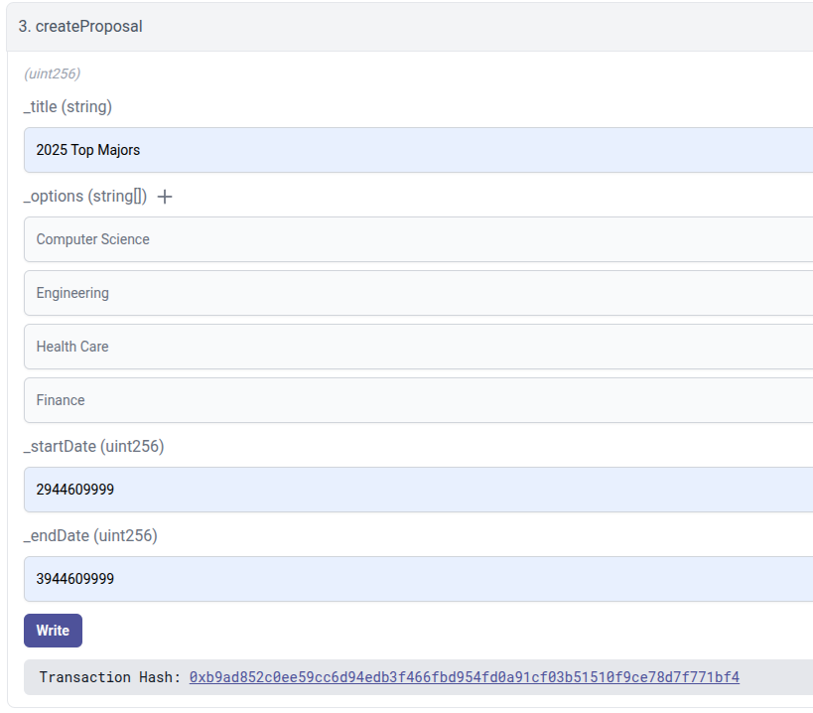
Creating Proposals
Create Proposal
Verify voter
Set proposal details
Save proposal

Slide 83
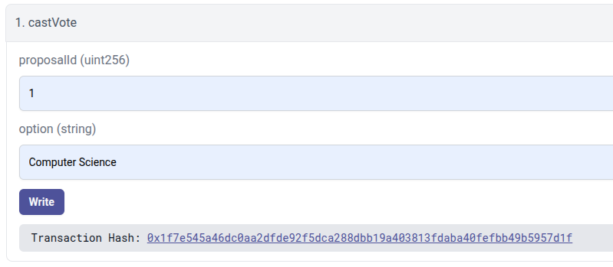
Casting Votes
Cast Vote
Verify voter
Check eligibility
Record vote

Slide 84
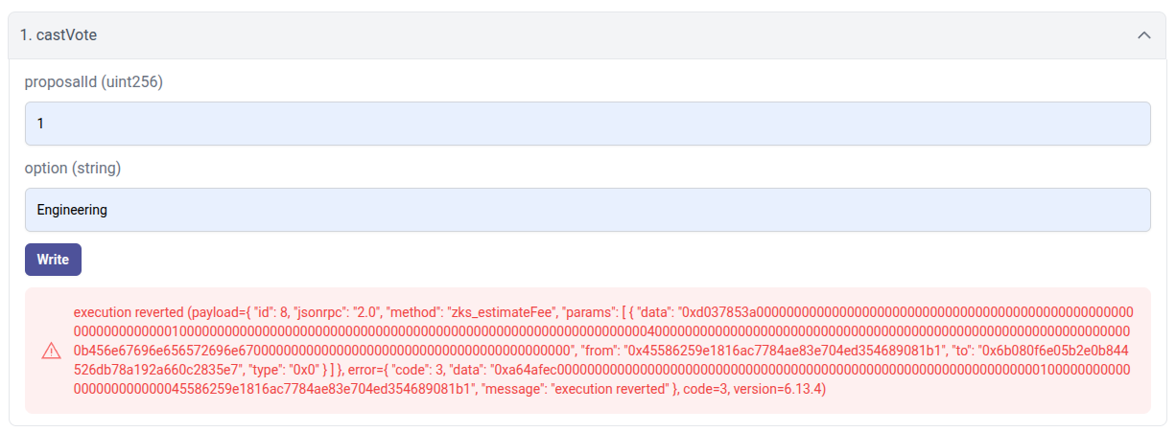
Only Once

Slide 85
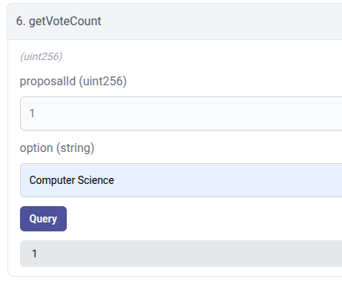
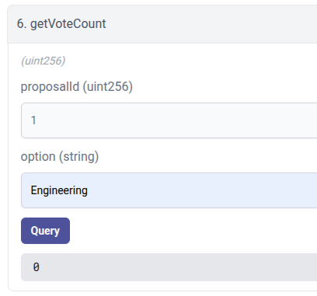
Viewing Vote Counts

Slide 86
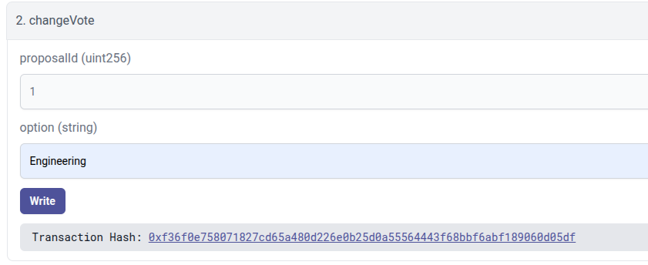
Changing Votes
Change Vote
Verify voter
Check eligibility
Update vote

Slide 87
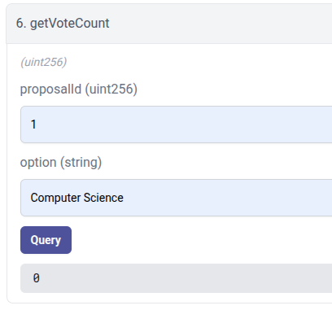
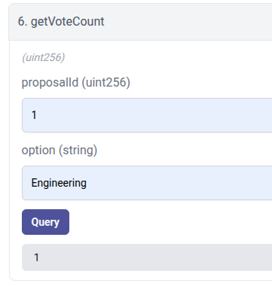

Slide 88
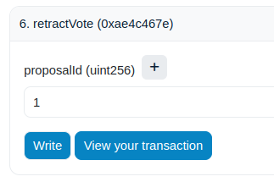
Retracting Votes
Retract Vote
Verify voter
Check eligibility
Remove vote

Slide 90
Deployment
zkSync
Ethereum L1

Slide 91


zkSync
$ 0.003
$ 0.019
$ 0.048
$ 0.177
Ethereum L1
$ 0.213
$ 0.592
$ 0.705
$ 2.057

Slide 92
Results Comparison:
Metric | zkSync | Ethereum L1
Deployment Time | ~2 seconds | ~20 seconds
Tx. Confirmation Time | ~0-1 minutes | ~3-9 minutes
Deployment Cost (USD) | $6.19 | $11.759
Avg Transaction Cost (USD) | $0.061 | $0.891
Transaction Throughput (Transactions per second) | ~2,000 TPS | 15-30 TPS

Slide 93
10
FRONTEND

Slide 94
DEMO TIME

Slide 95


Slide 96
11
TIME PLAN

Slide 97
October November December January February March April May
Survey
Dataset Preparation
Model Selection
Model Building
Smart Contract Development
Frontend Development
Smart Contract Auditing
System Integration
System Testing
Documentation

Slide 98
12
NEXT PHASE

Slide 99
NEXT PHASE
Models
Improve Performance
Reduce Complexity
Change some Preprocessing Technique
Differentiate between different id cards
BlockChain
Automatic change in the Proposal Status
Active, Pending, Closed
Determining the most voted Option.
Making the Contract Upgradable.
Encryption / Decryption Module

Slide 100
NEXT PHASE
Frontend
Voter History Page
Active Votes Page
System
Integration all The System Component
Test The System

Slide 101
TOOLS

Slide 102




TOOLS
ZK-Sync
Solidity
Python
Angular

Slide 103
REFERENCES

Slide 104
REFERENCES
[1] “VGGFace2: A dataset for recognising faces across pose and age” Qiong Cao, Li Shen, Weidi Xie, Omkar M. Parkhi and Andrew Zisserman Visual Geometry Group, Department of Engineering Science, University of Oxford {qiong,lishen,weidi,omkar,az}@robots.ox.ac.uk
[2] “Siamese Neural Networks for One-shot Image Recognition” Gregory Koch, Richard Zemel , Ruslan Salakhutdinov, Department of Computer Science, University of Toronto. Toronto, Ontario, Canada.
[https://www.cs.cmu.edu/~rsalakhu/papers/oneshot1.pdf]
[3] “FaceNet: A Unified Embedding for Face Recognition and Clustering” Florian Schroff, Dmitry Kalenichenko , James Philbin, Google Inc.
[https://www.cv-foundation.org/openaccess/content_cvpr_2015/papers/Schroff_FaceNet_A_Unified_2015
_CVPR_paper.pdf]
[4] “Learning Face Representation from Scratch” Dong Yi, Zhen Lei, Shengcai Liao and Stan Z. Li
Center for Biometrics and Security Research & National Laboratory of Pattern Recognition Institute of Automation, Chinese Academy of Sciences (CASIA)
[5] “Learning Robust Deep Face Representation” Xiang Wu University of Science and Technology Beijing Beijing, China

Slide 105
REFERENCES
[6]“Voting System Using Blockchain (Face Recognition)” Gaddam Harsha Vardhan, Swapnil Shah, Vanshika Gupta, Rohithreddy.B.C, Tanya Bisht
[6] “E-Voting using Blockchain: Moving Away from the Ballot Paper” Irvine Mutandiwa, Calvin P Mugauri, Maronge Musara
[7] “Blockchain-Based Electronic Voting: A Secure and Transparent Solution” Bruno Miguel Batista Pereira, José Manuel Torres, Pedro Miguel Sobral, Rui Silva Moreira, Christophe Pinto de Almeida Soares,
Ivo Pereira
[8] “Blockchain-Based E-Voting System with Face Recognition” V. Sathya Preiya, V. D. Ambeth Kumar, R. Vijay, Vijay K., N. Kirubakaran
[9] “A Blockchain-based Electronic Voting System: EtherVote” Achilleas Spanos Department of Informatics and Computer Engineering, University of West Attica Athens, Greece,
Ioanna Kantzavelou Department of Informatics and Computer Engineering, University of West Attica
Athens, Greece
[10] “A Privacy-Preserving Blockchain-based E-voting System” Arnab Mukherjee, Souvik Majumdar, Anup Kumar Kolya, Saborni Nandi

Slide 106
THANK YOU VERY MUCH!

Slide 107


Slide 108


Slide 109


Slide 110


Slide 111


Slide 112


Slide 114


Slide 116

AGENDA
01
02
03
Problem Definition
Objective
Motivation
04
05
06
Data Preprocessing
System
Architcure
Survey
07
08
09
Algorithms used & Results
Demo
Next Phase

Slide 117
TOOLS
ZK-Sync
Solidity
Python
Angular

Slide 118
Survey Conclusion
It may seem that Ethereum is the best blockchain for our goal, yet it isn't the most optimal choice!
Ethereum limitations:
Limited to 15-30 TPS, causing bottleneck during high demand.
Slower transaction processing with 10–15 seconds per block.
High and unpredictable transaction fees.
“Ethereum rough patch”:
On May 1, 2022, Ethereum's average transaction fee reached its all-time high, approximately $196.64 per transaction

Slide 119
From The Previous Seminar
Most common dataset used: VGGFace2
Preprocessing:
Face Detection
Face Alignment
Normalization
Augmentation
Cropping and Resizing
Filtering

Slide 120
IDENTITY VERIFICATION
AI-based facial recognition module will ensure voter authentication.

Slide 121
Blockchain
zk-Sync
A Layer 2 Ethereum scaling solution

Slide 122
ZK-SYNC
Security and Immutability: zkSync uses zero-knowledge proofs to ensure that all transactions are secure and immutable, meeting the system’s requirement for tamper-proof voting records.
Layer 1 Security: zkSync inherits the security guarantees of Ethereum Layer 1, meaning the system does not sacrifice any security while benefiting from scalability.
Smart Contract Support: zkSync is compatible with Solidity, enabling seamless development and integration of voting-related smart contracts.

Slide 123
ZK-SYNC
Scalability: Capable of handling thousands of transactions per second.
Cost-Efficiency: zkSync significantly reduces transaction fees up to 95-98% compared to Ethereum Layer 1, making it suitable for high-volume voting scenarios.

Slide 124
ZK-SYNC
Scalability: Capable of handling thousands of transactions per second.
Cost-Efficiency: zkSync significantly reduces transaction fees up to 95-98% compared to Ethereum Layer 1, making it suitable for high-volume voting scenarios.

Slide 125
SMART CONTRACTS
Smart contracts written in Solidity will handle the core voting logic, including vote casting, encryption, and result aggregation.

Slide 126
SMART CONTRACTS
Transparency: All voting operations are recorded on the blockchain, ensuring that the process is auditable and verifiable by all stakeholders.
Automation: Smart contracts eliminate the need for manual intervention by automating processes such as vote counting and validation.
Anonymity: The system will encrypt votes before storing them, ensuring that individual voter preferences remain private.
Tamper-Proof: Once deployed, the smart contract logic cannot be altered, ensuring trust in the system’s integrity.

Slide 127

UPGRADABLE SMART CONTRACTS
Implementation
Contract
0x6D1
0x5F6
User
Proxy
Contract

Slide 128

UPGRADABLE SMART CONTRACTS
0x6D1
0x5F6
User
Implementation
Contract
Proxy
Contract
0x2D5

Slide 129
UPGRADABLE SMART CONTRACTS
0x6D1
0x5F6
User
Proxy
Contract
0x2D5
Implementation
Contract
0xC4B

Slide 130

AGENDA
01
02
03
04
Problem Definition
Motivation
Scope
Objective
05
06
07
08
Identification of proposed methdologies
System
Architcure
Time Plan
Survey

Slide 131
03
SCOPE

Slide 132
OBJECTIVE
To implement a blockchain-based infrastructure for storing immutable voting records and enabling transparency in the voting process.
To incorporate AI-powered identity verification using facial recognition to ensure that only eligible voters can participate.
To create a User-Friendly and efficient platform for voters to register, log in, and cast their votes easily.
To enable users to securely change their vote if necessary while maintaining the integrity of the voting system.

Slide 133
05
SURVEY
Facial Recognition Survey
Blockchain Survey

Slide 134
Facial Recognition Survey
Paper | Dataset | Preprocessing | Feature Extraction | Models | Results Achieved
[1] Profile to Frontal Face Recognition in the Wild Using Coupled Conditional GAN | VGGFace2 | Images cropped and normalized; pose-specific templates created | ResNet-18 encoder with U-Net decoder | Coupled Conditional GAN (cpGAN) | Improved GAR at FAR of 0.01 to 93.8%
[2] VGGFace2: A Dataset for Recognizing Faces Across Pose and Age | VGGFace2 | Image cropping, resizing, normalization, and face alignment | ResNet-50 pre-trained on ImageNet for feature embeddings | CNN-based models such as ResNet-50, SENet | State-of-the-art performance on IJB-A, IJB-B, and IJB-C benchmarks

Slide 135
Paper | Dataset | Preprocessing | Feature Extraction | Models | Results Achieved
[3] Learning Face Representation from Scratch by Dong Yi et al. | CASIA-WebFace | Face alignment, normalization, and cropping | Deep feature extraction using CNNs | CNN | 97.3% accuracy on LFW benchmark
[4] Learning Robust Deep Face Representation by Xiang Wu | CASIA-WebFace | Face alignment, normalization | Feature embeddings using CNN | CNN-based model with robust representation learning | 98.4% accuracy on LFW benchmark
[5] Voting System Using Blockchain (Face Recognition) – IRJET | Custom voter face dataset | Image resizing, normalization, and face alignment | Facial embeddings using CNN (e.g., FaceNet) | Convolutional Neural Networks (CNN) | High authentication accuracy

Slide 136
Blockchain Survey
Paper | Publication Year | Blockchain | Smart Contract Language | Blockchain Layer | Limitations
[6] E-Voting using Blockchain: Moving Away from the Ballot Paper | 2023 | Ethereum | Solidity | Layer 1 | High computational cost, scalability concerns
[7] Blockchain-Based Electronic Voting: A Secure and Transparent Solution | 2023 | Ethereum | Solidity | Layer 1 | High computational cost, scalability concerns
[8] Blockchain-Based E-Voting System with Face Recognition | 2023 | Ethereum | Solidity | Layer 1 | High computational cost, scalability concerns
[9] A Blockchain-based Electronic Voting System: EtherVote | 2023 | Ethereum | Solidity | Layer 1 | High computational cost, scalability concerns
[10] A Privacy-Preserving Blockchain-based E-voting System | 2023 | Ethereum | Solidity | Layer 1 | High computational cost, scalability concerns

Slide 137


TRANSACTION FEES
zk-Sync
VS
Ethereum Mainnet

Slide 138
TRANSACTION FEES
zk-Sync
VS
Ethereum Mainnet

Slide 139
DATA CREATION
Filtering
some data filtered manually.
but for 32K, it is way hard.
so using some regex technique for names of images.
Duplicate Images
Name of images with National ID
this make a big difference.
but still the hard part for the similar data but different name and in random places.
so using some some CNN Network like..
Simple CNN Network.
MobileNetV2.
“of course with manual review”.

Slide 140
FACE VERIFICATION
WHY?
Fraud Prevention: Verifying the user’s facial image, we can prevent impersonation and unauthorized access.
Ease of Use: Users can easily verify their identity using their smartphone or computer.
Integration: AI verification integrates seamlessly with the blockchain to enable real-time eligibility checks, reducing administrative overhead.

Slide 141
FACE VERIFICATION
HOW?
by Comparing, the picture that he was uploaded in the signup and the other one came when he want to login.
then calculate the similarity (Distance) between them.
this can’t be Classification task
but it can solved by Recognition

Slide 142

Dataset: VGGFace2

Slide 143


BUT, Data is Missing
PROBLEM? NO

Slide 144

Model: InceptionResnet-V1
Overview
which combines Inception modules and residual connections.
also Pretrained on ‘Vggface2’
to handle the resources issue

Slide 145


Result
Validation
Test

Slide 146


Result
Validation
Test

Slide 147


Result
Validation
Test

Slide 148
Future Work
Automatic change in the Proposal Status
Active, Pending, Closed
Determining the most voted Option.
Making the Contract Upgradable.
Encryption / Decryption Module

Slide 150

AI
MODEL

Slide 151


